Slide 1

Online Bio-Informatics Toolkit
Cycle 2 Overview
Team 9: Benjamin Williams, Paul Ryu, Ansleigh Yancey, Sadaira Packer,
Mason Monday

Slide 2
System Metaphor
There is a lack of methods that organize genetic variants for diseases, tissues, and cell types. Advanced computational software is needed to help address this issue.
Our objective is to develop an interactive and online web application where users can:
search data by disease mutations types and human genetic signals
upload their own unique mutation datasets for their research
Tools:
R Language
Shiny Library
Shinyapps.io Server

Slide 3
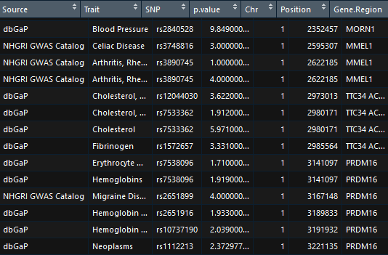
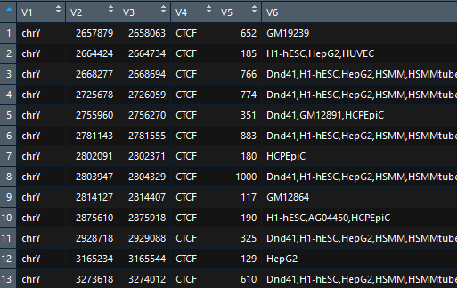
Cycle 2 Intent
Complete the implementation of the search functionality
Intersect mutation/disease data with human genome signal data
Develop a process where a user can dynamically replace the mutation dataset with a custom dataset

Slide 4
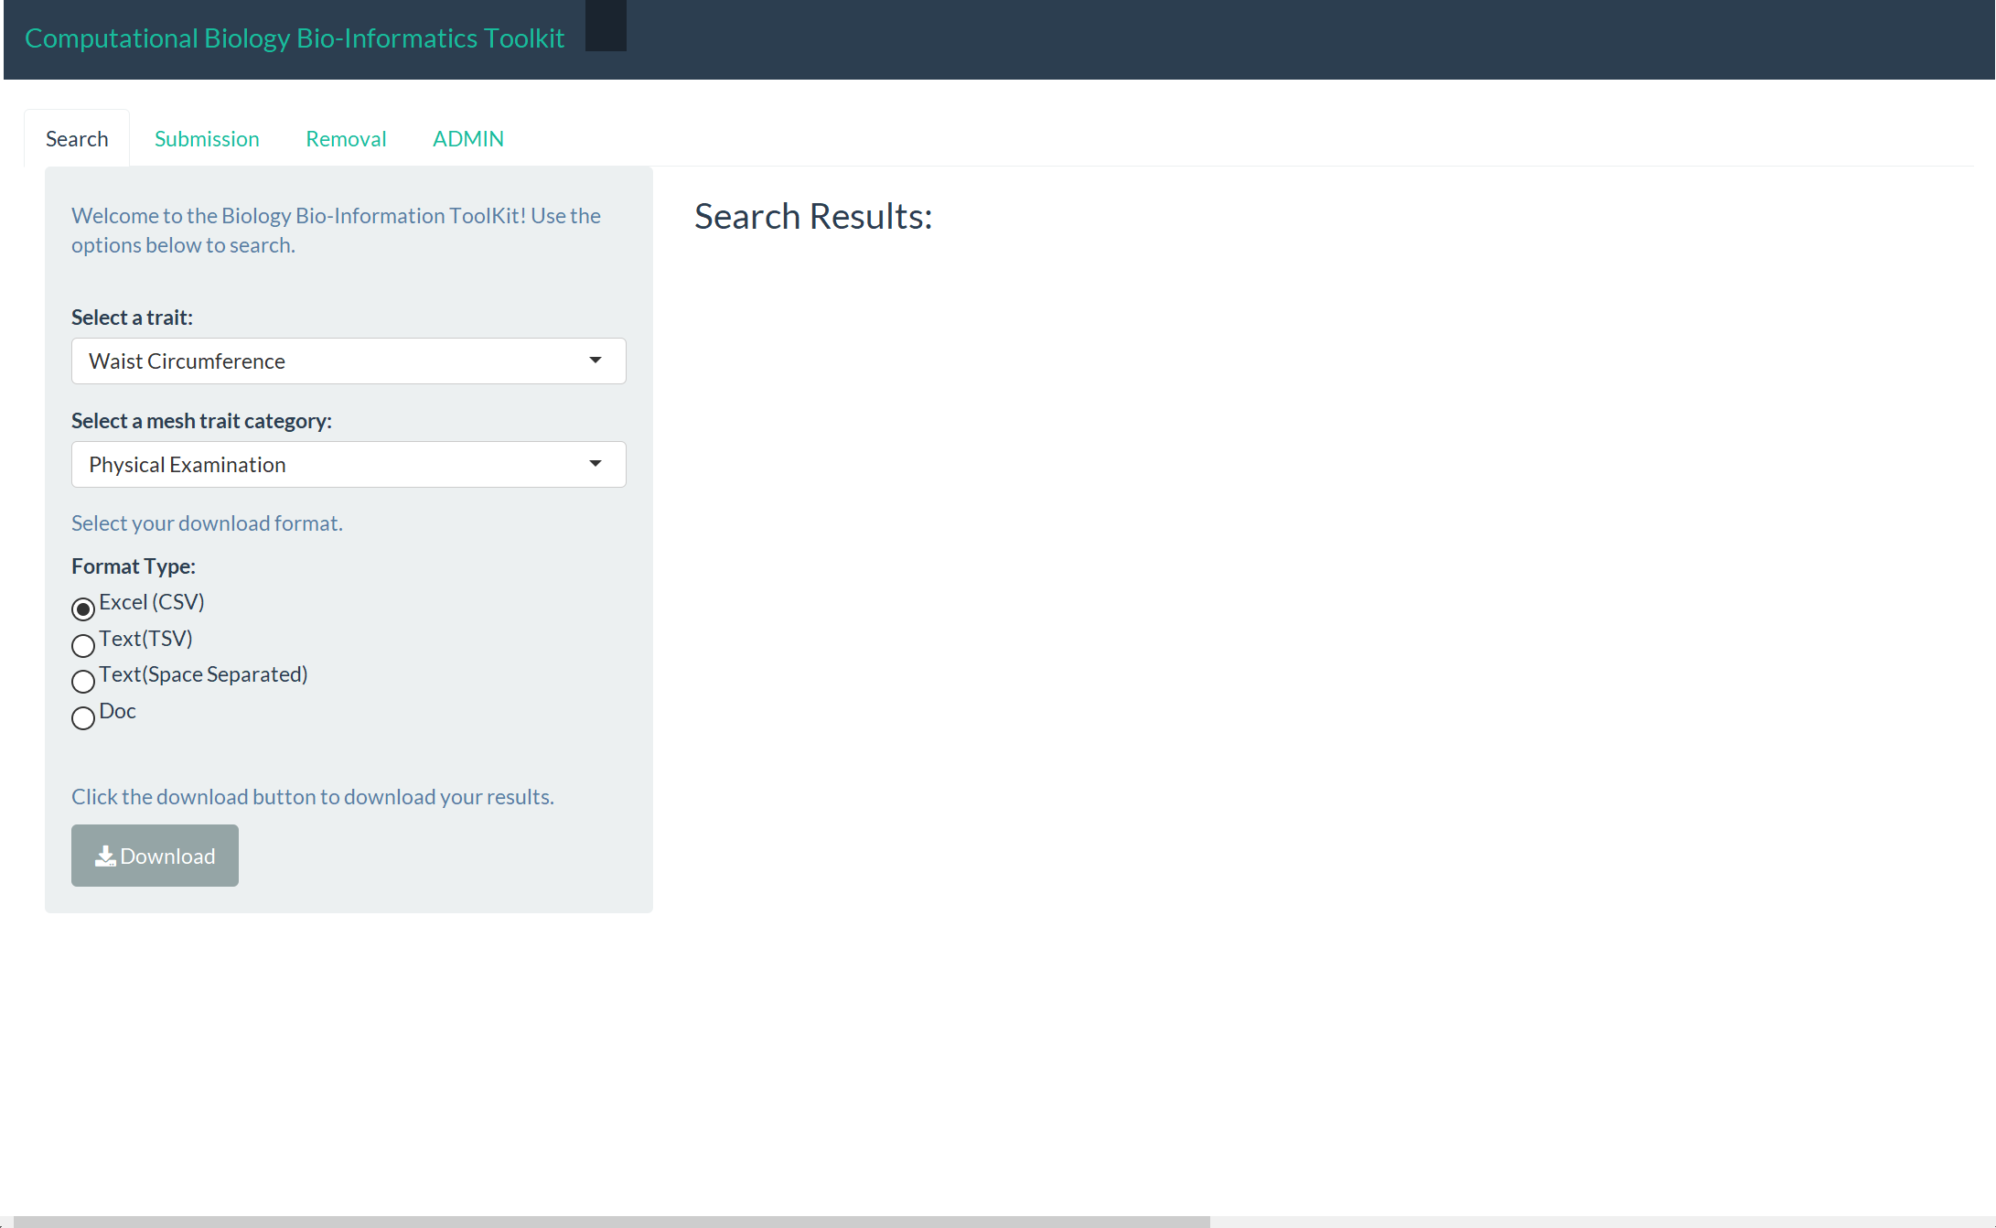
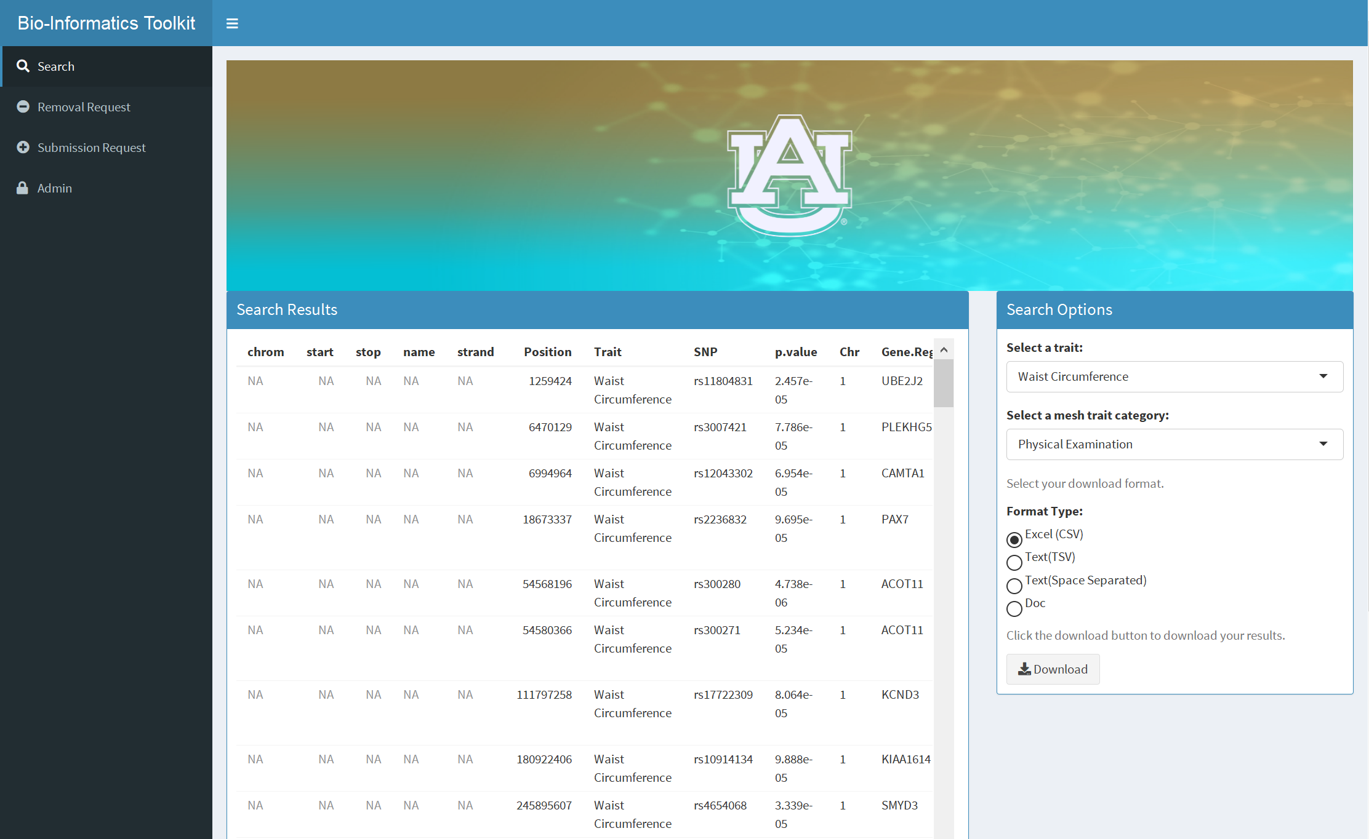
Front End
Change in the look and feel of all aspects of the website

Slide 5
Back End
Searching by Trait
Datasets intersected by chromosome type and the positions of nucleotides on a chromosome that relate to the selected trait
Algorithm is currently too slow
6-8 minutes to intersect both datasets
Example: Searching by “Waist Circumference”

Slide 6
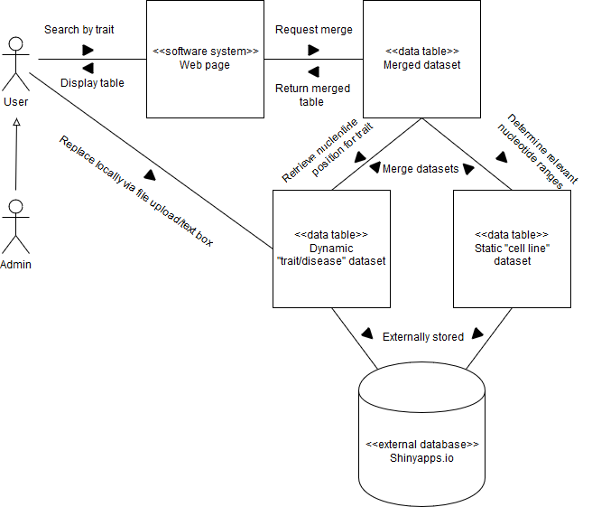
Data Manipulation

Slide 7
Lessons Learned
Ben: Developed experience with data organization and manipulation across multiple datasets in R Shiny.
Paul: I learned more about the Shiny library and how to construct data structures efficiently with it. I also learned to come prepared to the client with carefully chosen questions to prevent confusion and save a lot of time.

Slide 8
Future Plans
Speed up search algorithm
Import different datasets
Make results downloadable
Host on shinyapps.io

